Slide 1




Slide 2
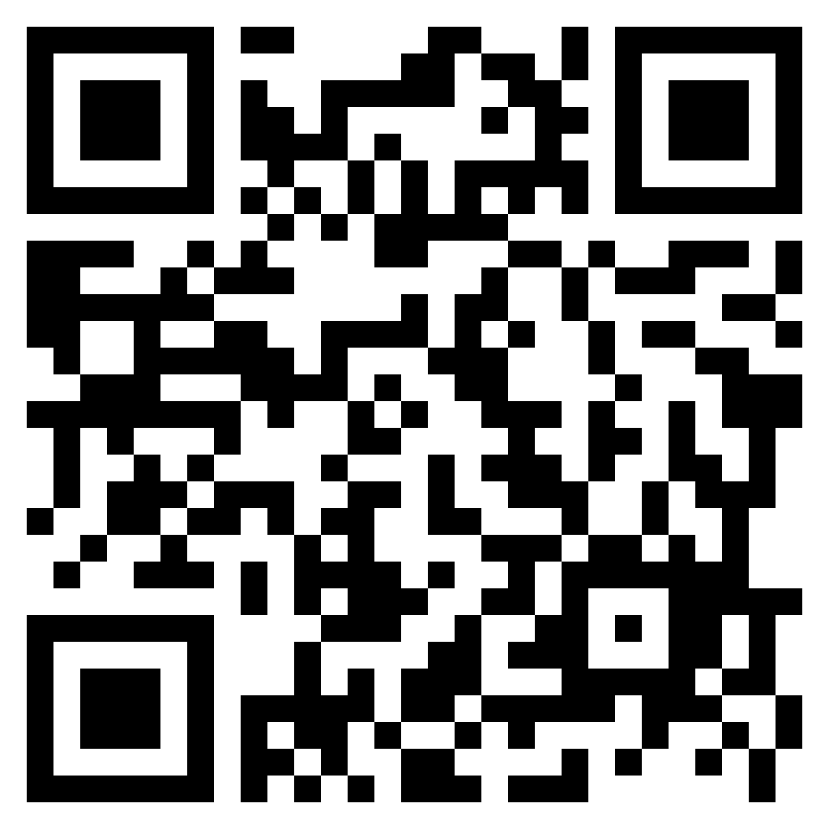
TEST TIME ON RESUME 1
URL: https://forms.gle/XBExUnYfUKUx39kQ6
QR CODE:

Slide 3

RESUME SKILLS -2

Slide 4

RESUME SKILLS
Types of resume
Notes:
This is the template for slides with only an image

Slide 5

RESUME SKILLS
What is resume ?
Notes:
A resume is a one- to two-page formal document submitted to job recruiters as means to see a list of an applicant's work experience, education and skills. The document is designed to provide a detailed summary of an applicant's qualifications for a job - it is not usually meant to provide a complete picture. A good resume gives the potential employer enough information to believe the applicant is worth interviewing. A one-page cover letter, submitted along with the resume, can provide additional information about the applicant's qualifications

Slide 6
RESUME SKILLS
Four types of resume :
Chronological
Functional
Combination
Targeted
Notes:
The four standard types of resumes include:
• Chronological
• Functional
• Combination
• Targeted
Chronological resume: Chronological resumes are the most commonly used format. They list work history in chronological order, starting with your most recent job down to your earliest. This resume is preferred by most employers because it provides a quick snapshot of work history, with most recent positions up front.
Functional resume: Unlike chronological resumes, functional resumes focus on your skills and experience first. This type of resume de-emphasizes the dates in which you have worked. Employment history is secondary and is listed under the details of your skills.
Who should use - If you have lapses in employment, are in the middle of a career transition, are a recent college grad with limited work experience, or have a diverse background with no clear career path, this is the most effective type of resume.
Combination resume: Combination resumes let you detail both your skills and experience, while also backing this up with a chronological listing of work history. Flexible in nature, the combination resume lets you tailor to the prospective job opening and tell hiring managers a story.
Who should use - Use this resume if you want to detail work experience to show hiring managers the type of employee you are.
Targeted resume: Targeted resumes are customized in detail to the prospective job you are seeking. Everything from your objective, your qualifications to educational experience mirrors the job requirements.
Who should use - These resumes are the most time-consuming but can generate the best results as the qualifications and experience you outline mirror the prospective job opening closely. Be careful, however When you develop a targeted resume you need to be as accurate as possible and not embellish career highlights simply to mirror the job.

Slide 7

RESUME SKILLS
Frequent mistakes in customizing resume
Notes:
This is the template for slides with only an image

Slide 8

RESUME SKILLS
RESUME SKILLS
Customization importance
Notes:
Many job seekers expend significant time and energy fine-polishing their resumes, wordsmithing the document until it is “perfect.” They then make a huge mistake by using that exact same resume for each job application. Your resume is a living, fluid document that should be customized for each job application. Resume listing specific needs, requirements makes the best resume for a job application The best resumes are built around the specific needs, requirements and hiring practices of the job at-hand.
● Customization helps you focus on the employer’s specific needs
● Customization helps you pass applicant tracking systems
● Customization shows you’re invested in the opportunity

Slide 9
RESUME SKILLS
RESUME SKILLS
Steps to customize a resume :
Analyse the job description
Customize your skills
Submitted resume
Highlight your matching skills
Confirm your location
Notes:
Customizing your resume in 5 Quick Steps is as follows:
1. Analyse the job description: Carefully read the job description. Make note of:
• The job title used in the description
• The duties and responsibilities
• The specific requirements
• The location
Don’t waste your time applying if you don’t meet at least 50 percent of the job’s requirements. Customize your resume “Target Job Title” or “Objective” to match the job title in each job description: Resume expert and author Martin Yate recommends using a “Target Job Title” at the top of your resume, below the standard name and contact information. If you want to be more traditional, you could call it “Objective,” just do NOT use an old - fashioned, meaningless, and keyword-less objective
2. Customize your skills : as appropriate, to match the terms used in the job description: Job description: Advanced knowledge of Microsoft applications (Word, Excel, PowerPoint) required. Ideally, assuming you do have the skills required, you would be smart to match the reference in your resume with the terms used in the job description.
3. Submitted resume: Advanced knowledge of Microsoft Office applications - Word, Excel, PowerPoint, Access, Publisher, OneNote, and Outlook. This matches the language in your resume with the language used in the description and should help your resume pass the keyword-matching requirements.
4. Highlight your matching skills in a special section at the top of the resume: Resume expert Martin Yate recommends capturing the human reviewer’s attention by clearly lining up your experience with the requirements in the job description in a section at the top of your resume, below your contact information and the “Target Job Title” or “Objective,” labelled “Performance Summary.” Other resume experts recommend naming the section, “Summary of Qualifications” or simply “Summary.”
In that section, which needs to have only 3 to 5 bullets for most jobs, pick your experiences or achievements that seem to best match the most important requirements in the job description. Or, the relevant achievements you have that are most impressive.
5. Confirm your location: The top of your resume should indicate your location, generally. Don’t publish your home or work addresses on your resume but do include a city, county, or other regional term that fit with the job’s location. Use your current location or, if you are trying to relocate, your future location. By including a location that fits with the employer’s requirements, you are confirming that you could be a good match. Employers are usually sensitive to the location of the job candidate in relation to the location of the job. They prefer to hire someone who is located near the job’s location.

Slide 10
RESUME SKILLS
RESUME SKILLS
Common mistakes to avoid in a resume and its fix :
Not Customizing Your Resume
Focusing on Job Functions Over Results
Including an Objective
Poor Writing
Leaving Out Social Media Links
Telling Instead of Showing
Notes:
1. Not Customizing Your Resume : When you’re applying to multiple jobs, it’s tempting to use a generic, cookie-cutter resume and blast it out everywhere you’re applying to. But that strategy may end up preventing your resume from getting in a recruiter’s hands at all. “Most resumes are reviewed electronically before a human sees them,” shares career coach Jeanne Patti, and if your resume doesn’t have the keywords specified in the job description, it will likely be overlooked by the software.
The Fix: It may be a pain to create a customized resume for each company, but if you’re truly interested in a position, it’s worth it.
2. Focusing on Job Functions Over Results : If your resume reads like the original job description you saw when you applied, it’s time to spice it up.
The Fix: Instead of talking about the day- to-day, describe the big picture impact you had.
3. Including an Objective : If your college career counsellor ever told you to put an objective like “Find an entry- level position in marketing” at the top of your resume, we’re giving you full permission to disregard them.
The Fix: Don’t just say you want a job show recruiters why they should hire you for the job with a professional summary. “Think of a professional summary as an introduction to the novel about yourself. It should allure the reader and entice him/her with information that will make him/her want to continue on reading to learn more.”
4. Poor Writing : When it comes to your resume, your experience and career accomplishments are the most important, but how you present that information comes in at a close second. Spelling mistakes, clichés, and complex, industry-specific jargon will all count against you.
The Fix: “The easiest way to improve your choice of words is to read your resume out loud to yourself. This can catch many of the potential issues before anyone else sees it. Then, ask a friend or family member who works in another industry to read it. If they find your resume to be confusing, consider updating the wording, so that it’s clearer.”
5. Leaving Out Social Media Links : “Many people aren’t using the presence of social media to their advantage and use their resume as a stand-alone document”. But in a constantly connected world where being transparent and informed is critical at every stage of the hiring process, it only makes sense to add links to your professional social media profiles.
The Fix: Give another layer of depth to your resume by linking to relevant, professional social media links.
6. Telling Instead of Showing : It’s an age-old adage in writing: show, don’t tell. When job seekers simply state how great they are without providing any evidence, they lose credibility in recruiters’ eyes. One common way job seekers do this is by “using buzzwords”.
The Fix: One common approach is the STAR method — provide the situation, task, action, and result of different initiatives you have been involved in, making sure to include specific information like metrics as relevant.

Slide 11

RESUME SKILLS
Layout- Understanding different company's requirements
Notes:
This is the template for slides with only an image

Slide 12
RESUME SKILLS
RESUME SKILLS
Tactics to improve resume performance:
You must have a job-targeted resume
Always use a Target Job Title
Replace Career Objective with a Performance Profile
Add a Professional Skills section
The first page must tell the complete story
Notes:
Here are five important tactics that improve resume performance:
• You must have a job-targeted resume : A resume describing all you have done is too unfocused, especially for transition to a new industry, and it won't get pulled from the databases. Your resume must demonstrate a clear match between your skills and employers' stated needs for a specific job. When your resume focuses on a single target job and tells the story that best qualifies you for that job, you directly respond to employers' needs and your resume will become a more productive marketing tool.
• Always use a Target Job Title : A clear Target Job Title, coming right after your contact information, helps resume performance in database searches and gives the reader immediate focus: "Ah, this fits the need I'm trying to fill."
• Replace Career Objective with a Performance Profile : Replace what you want with the skills you bring to your Target Job Title. Whenever possible, use words and phrases common to job postings from the target industry.
• Add a Professional Skills section : This is a list of keywords that describe your hard skills. It makes your resume discoverable in database searches and tells a recruiter that, "This person understands, and has the tools, to do this job." This section also tells you the keywords that need to be repeated in the body of your resume to put them in context and, of course, to maximize database performance.
• The first page must tell the complete story : A Target Job Title, followed by a Performance Profile that addresses the abilities employers in the new target industry seek, followed by a Professional Skills section, make a powerful first impression and tell the reader that you can do this job well before the details of your industry experience are discussed.

Slide 13
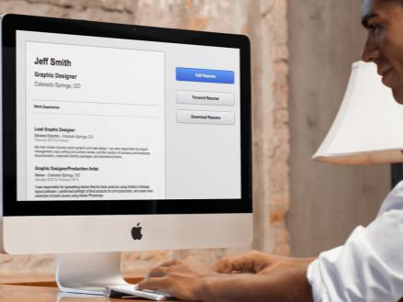
RESUME SKILLS
Digitizing career portfolio
Notes:
The trickiest part of putting together your digital resume is deciding how much personal information you want to post on the Internet. You need to present your work history in a professional way, but you don’t want to give identity thieves or spammers too much personal information. Here are a few pointers:
• Don’t include your physical address: Consider spelling out your email address (example: “yourname at domain.com” instead of yourname@domain.com).
• Keep to the basics for your job listings: company, job title and tenure. Long job descriptions are distracting.
• Delete your “personal interest” section.
• Try adding a "skills" section to highlight your technological experience.
• Post the content of resume directly on blog in an "About Me" section. Many writers use these sections instead of a traditional resume because potential employers can quickly view their work history without opening or downloading a new document.
• Before you start designing your digital resume, take a few minutes to search the Web for examples of what other writers have done.

Slide 14
RESUME SKILLS
RESUME SKILLS
Do's and dont's in a resume:
DO tailor your resume to each job you are applying to
DO showcase your talents and skills relate to the job
DO highlight your time in the armed forces
DON’T fake credentials
DON’T send that resume on bright neon green paper
DON’T rely on gimmicks
Notes:
Here are some do’s and don’ts for customizing that resume.
1. DO tailor your resume to each job you are applying to : Be sure to really read the job description for the job you are applying to. Don’t just send the same generic resume to job after job. Taking the time to tailor your resume to the specific requirements of each job will help your resume stand out from the pile.
2. DO showcase your talents and skills as they relate to the job keywords : Suzanne Lucas, in an article for CBS News, makes a great point that, when customizing your resume, “make your language match.” This means make sure the language within your resume matches the main keywords from the job description. As Lucas notes, “This is not lying. This is about careful word choice.” This will help show the employer you have the specific skills and work experience they are looking for.
3. DO highlight your time in the armed forces : Be sure to highlight your time in the armed forces on your resume but include how that experience translates to what the employer is looking for. Does the job require strong leadership skills? Then showcase how your time in the armed forces translates to strong leadership skills.
4. DON’T fake credentials : Faking credentials or lying on a resume is a big-time don’t. The best course of action is honesty. Your experience will speak for itself.
5. DON’T send that resume on bright neon green paper : Customization is a great thing, but it can go too far. Don’t send your resume on bright neon green paper. Think professional, sharp-looking and error-free. That will keep your resume on the top of the stack.
6. DON’T rely on gimmicks : Gimmicky resumes often turn off employers. Things such as crazy font sizes and weird formatting will more than likely get your resume tossed. Employers are looking for easy-to-read, professional and to-the-point resumes. Customizing your resume is a must do when applying to jobs. Keep the customization to highlighting your talents and experience and away from the bright neon paper in your printer.

Slide 15
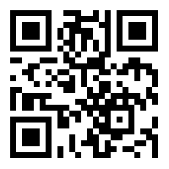
https://learn.codemithra.com

Slide 16




THANK YOU
+91 78150 95095
codemithra@ethnus.com
www.codemithra.com

